Slide 1
Digitization of Tamil Text
Peratchi Hariharasudhan Kannan U6366102
Vinayak Ravi U6561524

Slide 2
Necessity
Various techniques to do OCR/ pattern recognition for English and numerals are available.
Available techniques are predominantly SVM based
Aims to better classify the text

Slide 3
Data collection
50683 images with 155 classes
Varied in sizes
Dimensions reduced uniformly to 32x32x1

Slide 4
Parameter combinations
Learning rate
0.001
0.01 (default)
0.1
Minibatch size
32
64
128 (default)
Optimizer
Adam
Stochastic Gradient Descent

Slide 5
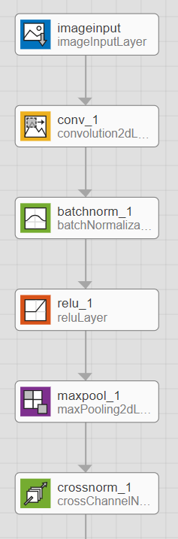
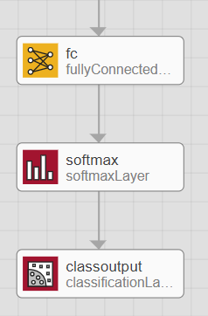
Our approach
Structure

Slide 6
Flow chart
Pre-processing
Image Scaling
Input image
CNN
ROI – Feature extraction and matching
Decision Making
Class

Slide 7
Troubles faced
Finding the right data (Insufficient data/ Data Augmentation)
Finding the right activation function (tanh/ReLU)
Parameter selection (Learning rate/ Optimizer)

Slide 8
Future recommendations and Conclusions
Gathering more data

